Slide 1
Predicting the Energy Output of wind turbine based on weather conditions
Madhav Jaideep

Slide 2
Index
Introduction
Road Map
Advantages and Disadvantages
Conclusion

Slide 3
Road Map
2.Data
Collection
4.Model
Design
3.Data
Pre-processing
1.Planning
5.Application
Design

Slide 4
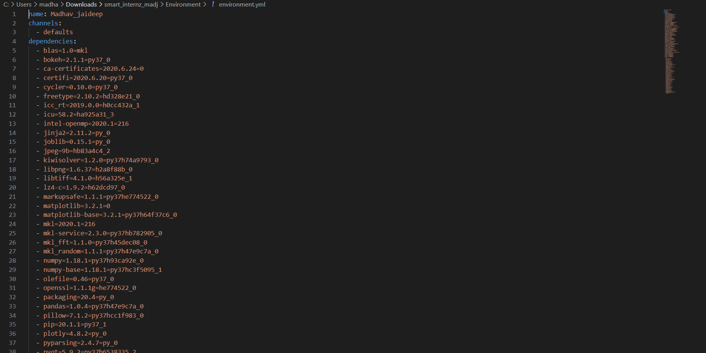
Environment setup
Setting up the environment for using the files and data using YAML coding.

Slide 5
Data Collection
We used the wind turbine dataset from Kaggle provided in the description of the problem and downloaded the weather conditions data of the same place and of the same time from the web.

Slide 6
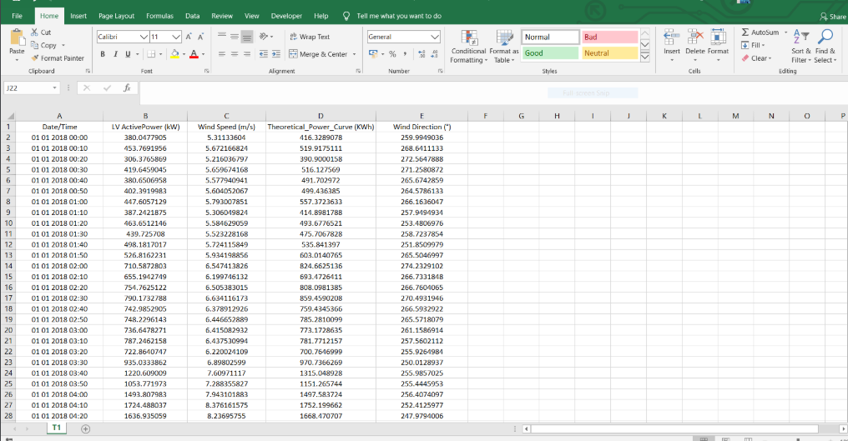
Kaggle Data

Slide 7
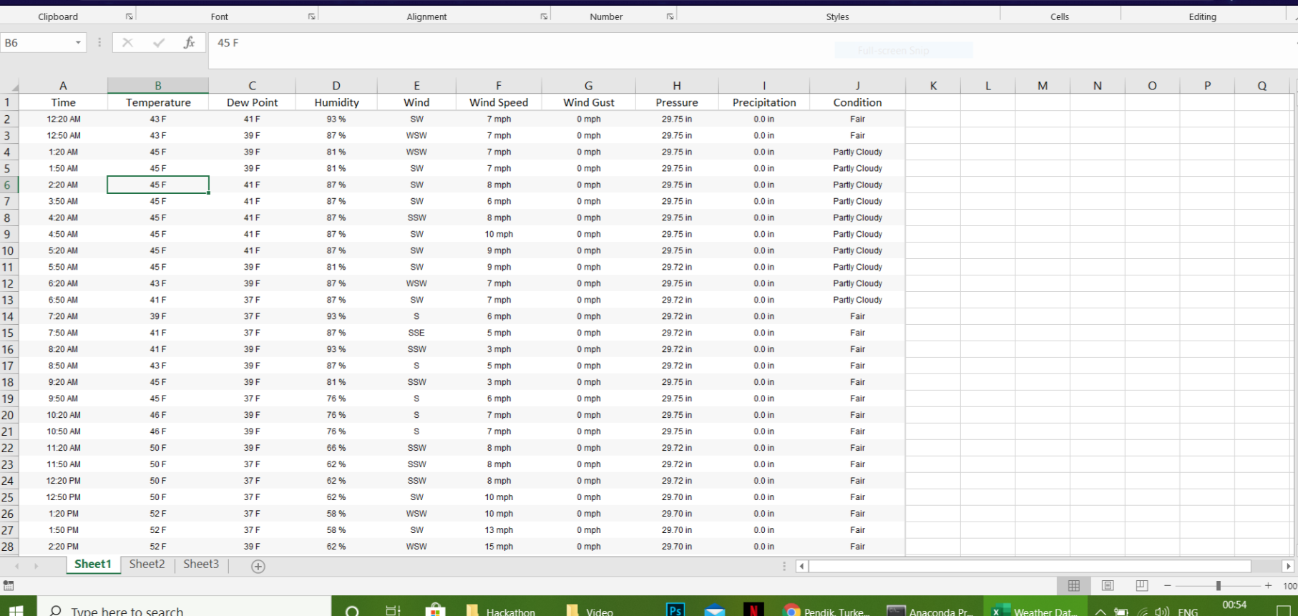
Weather Data

Slide 8
Data pre-processing
Activity 1 : Taking care of the missing data
Solution - The missing data is less than 5% of the total data so we have filled the missing data by the average value of the respective column data.
Activity 2 : Feature scaling
Solution - Weather data has a scale of 30 minutes while the wind turbine data from Kaggle has a scale of 10 minutes so in order to merge both the data's we have converted each of them into the same scale (i.e. scale of 30 minutes). Then we merged both the data's into one and obtained our final data.

Slide 9
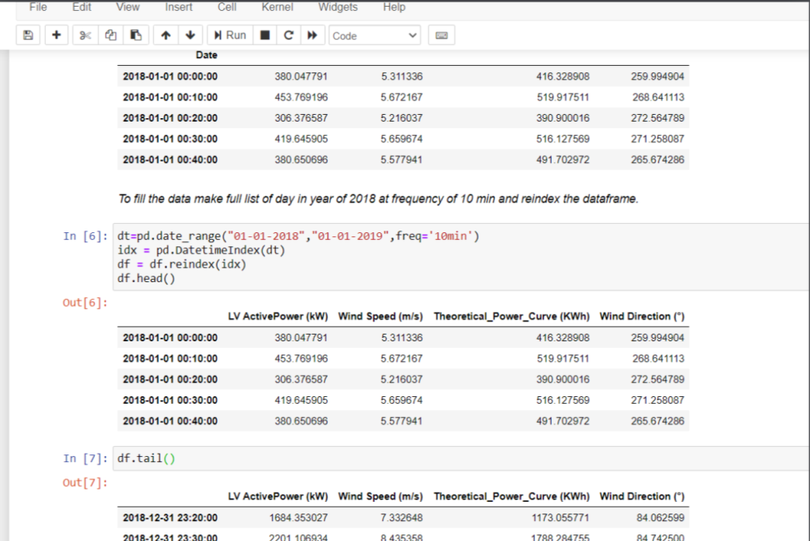
Code Screenshot
Handle Missing Data

Slide 10
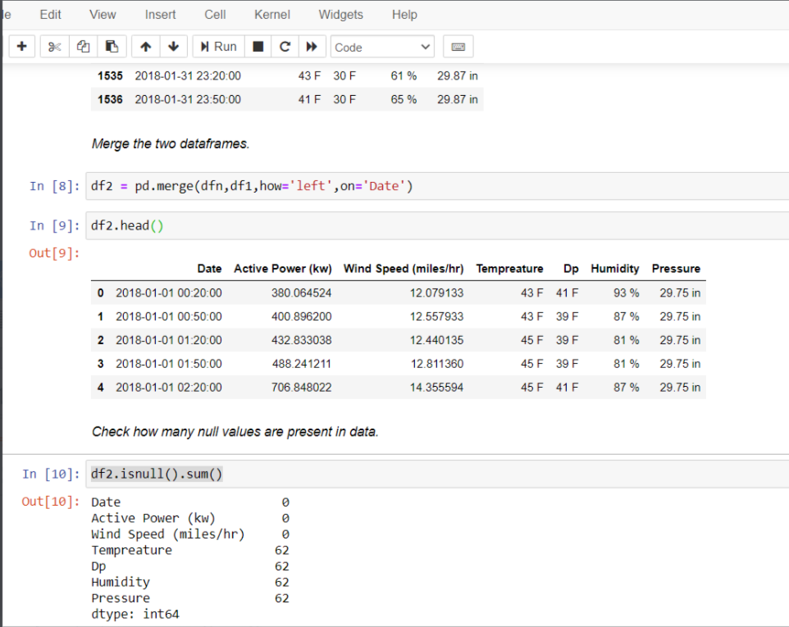
Code Screenshot
Merging of Data

Slide 11
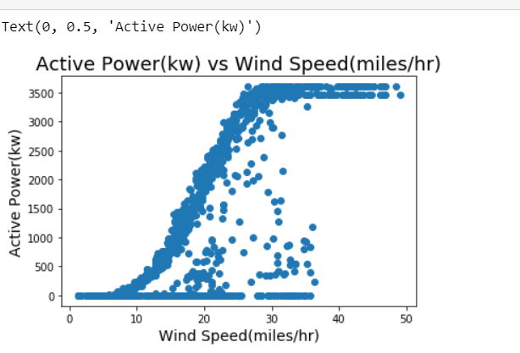
Activity 3: Visualization of the Data
Solution- We analyzed the data and studied the impact of different features on output (active power). With the results we achieved, we eradicated all the unnecessary features from the model

Slide 12
Model Design
Activity 1: Deciding parameters or features
Solution- With the results we achieved we have selected following as our features for the model :
1.Wind Speed
2.Temperature
3.Humidity
4.Pressure
Activity 2: Separating Training and Testing data from the data set
Solution- This process will be done inside the model file itself by using the train_test_split library in the sklearn package of python.
Activity 3: Developing the model
Solution- We use the boosted trees regressor model to train and evaluate the model using TensorFlow. We decided to train the model using 120 trees to optimize the model and preventing it from underfit also we have used entire batch of training data to train so that model can accurately be trained.

Slide 13
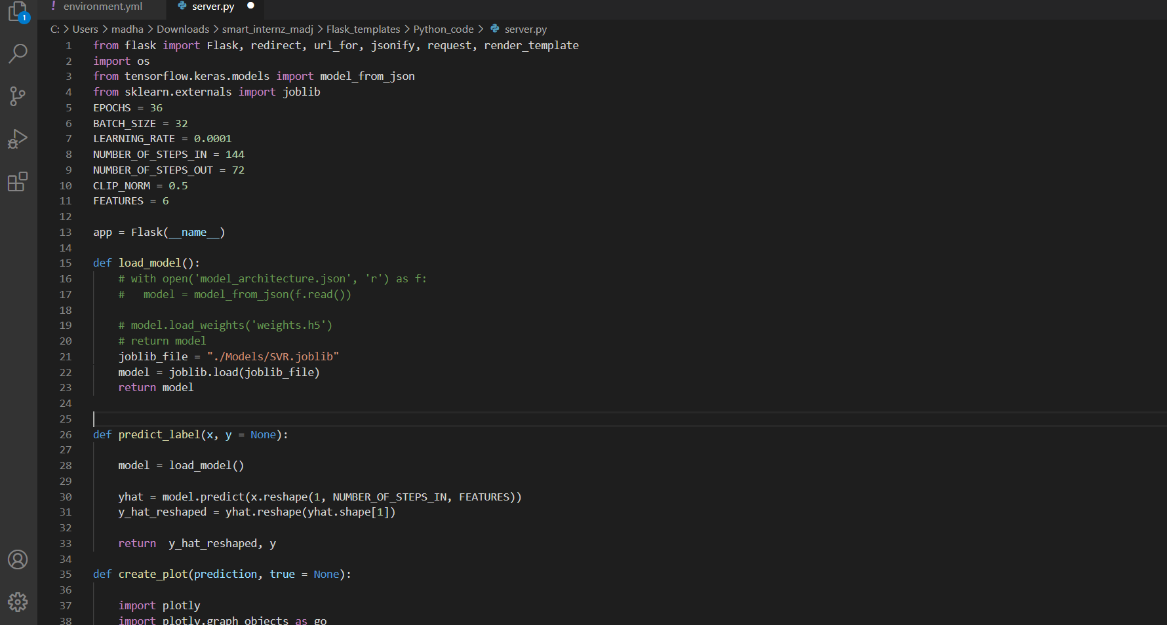
Screenshot of python server code

Slide 14
Application Design
The product designing involves training a model and deploying it using flask .The flask app is then deployed in PaaS infrastructure by Cloud Service providers. The flask app is designed as a RESTful API ,where the User Interface curls the result from server and displays it to the user.
LSTM Networks. Long Short Term Memory networks – usually just called “LSTMs” – are a special kind of RNN, capable of learning long-term dependencies. They were introduced by Hochreiter & Schmidhuber (1997), and were refined and popularized by many people in following work

Slide 15
Advantages and Disadvantages
ADVANTAGES
Weather Underground Services provide very accurate Historical Weather Data which increased the accuracy of model.
Accurate wind power forecasts are also important in reducing the occurrence or length of curtailments (which translate to cost savings), improved worker safety, and mitigating the physical impacts of extreme weather on wind power systems.
Wind speed forecasting naturally has greater value where balancing markets are part of a competitive trading system for electricity, because the balancing market provides financial incentives to the generators and retailers for accurate output predictions

Slide 16
DISADVANTAGES
The challenges to face when wind generation is injected in a power system depend on the share of that renewable energy.
Wind turbines are noisy. Each one can generate the same level of noise as a family car travelling at 70 mph.
When wind turbines are being manufactured some pollution is produced.

Slide 17
Applications
As we all know Renewable energy is the future of energy and wind mills is one that would be mostly used as a renewable source of energy because it takes less space as compared to others, more efficient and doesn't harm the environment in any way, that's why this system will be high in demand for cost reduction in construction and maintenance when constructing it according to the weather of the given place and will also help in increasing the efficiency of the energy output.

Slide 18
Conclusion
In this project, we have established the application to predict future wind power output values based on the regressor and deep learning models. The UI provides a great deal of information to anyone who would like to know about the future power output presented in the form of visualizations. Deploying it to the cloud makes it more scalable. The product can increase the accuracy of the forecasting the output from the wind turbine .Overall accurate wind power prediction reduces the financial and technical risk of uncertainty of wind power production for all electricity market participants

